Slide 1
Hardware Design Overview

Slide 2
Digital Design Flow in FPGA
Architecture Design
Hardware Description
Behavioral Simulation
Synthesis
Implementation
Bitfile

Slide 3
Digital Design Flow in FPGA
Architecture Design
Hardware Description
Behavioral Simulation
Synthesis
Implementation
Bitfile
Architecture Diagram

Slide 4
Digital Design Flow in FPGA
Architecture Design
Hardware Description
Behavioral Simulation
Synthesis
Implementation
Bitfile
Architecture Diagram
Writing the HDL

Slide 5
Digital Design Flow in FPGA
Architecture Design
Hardware Description
Behavioral Simulation
Synthesis
Implementation
Bitfile
Architecture Diagram
Writing the HDL
Functional Correctness

Slide 6
Digital Design Flow in FPGA
Architecture Design
Hardware Description
Behavioral Simulation
Synthesis
Implementation
Bitfile
Architecture Diagram
Writing the HDL
Functional Correctness
Netlist Generation

Slide 7
Digital Design Flow in FPGA
Architecture Design
Hardware Description
Behavioral Simulation
Synthesis
Implementation
Bitfile
Architecture Diagram
Writing the HDL
Functional Correctness
Netlist Generation
Place & Route

Slide 8
Digital Design Flow in FPGA
Architecture Design
Hardware Description
Behavioral Simulation
Synthesis
Implementation
Bitfile
Architecture Diagram
Writing the HDL
Functional Correctness
Netlist Generation
Place & Route
FPGA Programming

Slide 9
Multiplexer Built From Primitives
module mux(f, a, b, sel);
output f;
input a, b, sel;
and g1(f1, a, nsel),
g2(f2, b, sel);
or g3(f, f1, f2);
not g4(nsel, sel);
endmodule
Verilog programs built from modules
Each module has an interface
Module may contain structure: instances of primitives and other modules
a
f1
nsel
g1
g4
g3
f
b
g2
sel
f2

Slide 10
Multiplexer Built From Primitives
module mux(f, a, b, sel);
output f;
input a, b, sel;
and g1(f1, a, nsel),
g2(f2, b, sel);
or g3(f, f1, f2);
not g4(nsel, sel);
endmodule
Identifiers not explicitly defined default to wires
a
f1
nsel
g1
g4
g3
f
b
g2
sel
f2

Slide 11
Multiplexer Built With Always
module mux(f, a, b, sel);
output f;
input a, b, sel;
reg f;
always @(a or b or sel)
if (sel) f = b;
else f = a;
endmodule
Modules may contain one or more always blocks
Sensitivity list contains signals whose change triggers the execution of the block
a
f
b
sel

Slide 12
Multiplexer Built With Always
module mux(f, a, b, sel);
output f;
input a, b, sel;
reg f;
always @(a or b or sel)
if (sel) f = b;
else f = a;
endmodule
A reg behaves like memory: holds its value until imperatively assigned otherwise
Body of an always block contains traditional imperative code
a
f
b
sel

Slide 13
Mux with Continuous Assignment
module mux(f, a, b, sel);
output f;
input a, b, sel;
assign f = sel ? b : a;
endmodule
LHS is always set to the value on the RHS
Any change on the right causes re-evaluation
The infamous error: "concurrent assignment to a non-net is not permitted"
a
f
b
sel

Slide 14
Identifiers in Verilog
Any Sequence of letter, digits, dollar sign, underscore.
First character must be a letter or underscore.
It cannot be a dollar sign.
Cannot use characters such as hyphen, brackets, or # in verilog names

Slide 15
Verilog Logic Values
Predefined logic value system or value set
: ‘0’, ‘1’ ,’x’ and ‘z’;
‘x’ means uninitialized or unknown logic value
‘z’ means high impedance value.

Slide 16
Verilog Data Types
Nets: wire, supply1, supply0
  wire:
i) Analogous to a wire in an ASIC.
ii) Cannot store or hold a value.
Integer: used for the index variables of say for loops. No hardware implication.

Slide 17
The reg Data Type
Register Data Type: Comparable to a variable in a programming language.
Default initial value: ‘x’
module reg_ex1;
reg Q; wire D;
always @(posedge clk) Q=D;
A reg is not always equivalent to a hardware register, flipflop or latch.
module reg_ex2; // purely combinational
reg c;
always @(a or b) c=a|b;
endmodule

Slide 18
Difference between driving and assigning
Programming languages provide variables that can contain arbitrary values of a particular type.
They are implemented as simple memory locations.
Assigning to these variables is the simple process of storing a value into the memory location.
Verilog reg operates in the same way. Previous assignments have no effect on the final result.

Slide 19
Example
module assignments;
reg R;
initial R<=#20 3;
initial begin
R=5; R=#35 2;
end
initial begin
R<=#100 1;
#15 R=4;
#220;
R=0;
end
endmodule
The variable R is shared by all the concurrent blocks.
R takes the value that was last assigned.
This is like a hardware register which also stores the value that was last loaded into them.
But a reg is not necessarily a hardware register.

Slide 20
Wire: helps to connect
Consider a set of tristate drivers connected to a common bus.
The output of the wire depends on all the outputs and not on the last one.
To model connectivity, any value driven by a device must be driven continuously onto that wire, in parallel with the other driving values.

Slide 21
Code
module simple(A,B,C,sel,Z);
input A, B, C;
input [1:0] sel;
output Z;
reg Z;
always @(A or B or C or SEL)
begin
2’b00: Z=1’bz;
2’b01: Z=A;
2’b10: Z=B;
2’b11: Z=C;
endcase
end
endmodule
module simple(A,B,C,sel,Z);
input A, B, C;
input [1:0] sel;
output Z;
assign Z=(SEL==2’b01)?A: 1’bz;
assign Z=(SEL==2’b10)?B:1’bz;
assign Z=(SEL==2’b11)?C:1’bz;
endmodule
Inferred as a multiplexer.
But we wanted drivers!

Slide 22
Code
module tristate_bus (
input wire enable1, enable2,
input wire [7:0] data1, data2,
output wire [7:0] bus
);
assign bus = enable1 ? data1 : 8'bz; // Tristate driver 1
assign bus = enable2 ? data2 : 8'bz; // Tristate driver 2
endmodule
If enable1 is 1 and enable2 is 0, bus takes data1.
If enable2 is 1 and enable1 is 0, bus takes data2.
If both enable signals are 1 and data1 ≠ data2, the bus enters an undefined (x) state due to contention.

Slide 23
Code
module tristate_bus (
input [7:0] data1, data2,
output [7:0] bus
);
assign bus = data1
assign bus = data2
endmodule
Error: "Net out_signal has multiple drivers."

Slide 24
Code
module multi_driver_error (
input wire clk,
input wire rst,
output reg out_signal
);
always @(posedge clk) begin
if (rst)
out_signal <= 0; // First driver
end
always @(posedge clk) begin
out_signal <= 1; // Second driver (Conflicting)
end
endmodule
Error: "Signal out_signal has multiple drivers. "

Slide 25
Code
module multi_driver_fix (
input wire clk,
input wire rst,
output reg out_signal
);
always @(posedge clk) begin
if (rst)
out_signal <= 0;
else
out_signal <= 1;
end
endmodule

Slide 26
Numbers
Format of integer constants:
Width’ radix value;
Verilog keeps track of the sign if it is assigned to an integer or assigned to a parameter.
Once verilog looses sign the designer has to be careful.

Slide 27
Hierarchy
Module interface provides the means to interconnect two verilog modules.
Note that a reg cannot be an input/ inout port.
A module may instantiate other modules.

Slide 28
Instantiating a Module
Instances of
module mymod(y, a, b);
Lets instantiate the module,
mymod mm1(y1, a1, b1); // Connect-by-position
mymod mm2(.a(a2), .b(b2), .y(c2)); // Connect-by-name

Slide 29
Instantiating a Module
module top_module;
reg [3:0] x, y;
wire [3:0] result;
adder4 uut (x, y, result);
initial
begin
x = 4'b0011;
y = 4'b0101;
#10;
end
endmodule
module top_module;
reg [3:0] x, y;
wire [3:0] result;
adder4 uut (.a(x), .b(y), .sum(result));
initial
begin
x = 4'b0011;
y = 4'b0101;
#10;
end
endmodule
module adder4 ( input [3:0] a, input [3:0] b, output [3:0] sum );
assign sum = a + b;
endmodule

Slide 30
Sequential Blocks
Sequential block is a group of statements between a begin and an end.
A sequential block, in an always statement executes repeatedly.
Inside an initial statement, it operates only once.

Slide 31
Procedures
A Procedure is an always or initial statement or a function.
Procedural statements within a sequential block executes concurrently with other procedures.

Slide 32
Assignments
module assignments
// continuous assignments
always // beginning of a procedure
begin //beginning of a sequential block
//….Procedural assignments
end
endmodule
A Continuous assignment assigns a value to a wire like a real gate driving a wire.
module holiday_1(sat, sun, weekend);
input sat, sun; output weekend;
// Continuous assignment
assign weekend = sat | sun;
endmodule
module holiday_2(sat, sun, weekend);
input sat, sun; output weekend;
reg weekend;
always @(sat or sun)
weekend = sat | sun; // Procedural
endmodule // assignment

Slide 33
Blocking and Nonblocking Assignments
Blocking procedural assignments must be executed before the procedural flow can pass to the subsequent statement.
A Non-blocking procedural assignment is scheduled to occur without blocking the procedural flow to subsequent statements.

Slide 34
Nonblocking Statements are odd!
a = 1;
b = a;
c = b;
Blocking assignment:
a = b = c = 1
a <= 1;
b <= a;
c <= b;
Nonblocking assignment:
a = 1
b = old value of a
c = old value of b

Slide 35
Nonblocking Looks Like Latches
RHS of nonblocking taken from latches
RHS of blocking taken from wires
a = 1;
b = a;
c = b;
“
a
b
c
”
1
1
a
a <= 1;
b <= a;
c <= b;
“
b
”
c

Slide 36
Examples
Blocking:
always @(A1 or B1 or C1 or M1)
begin
M1=#3(A1 & B1);
Y1= #1(M1|C1);
end
Non-Blocking:
always @(A2 or B2 or C2 or M2)
begin
M2<=#3(A2 & B2);
Y2<=#1(M1 | C1);
end
Statement executed at time t causing M1 to be assigned at t+3
Statement executed at time t+3 causing Y1 to be assigned at time t+4
Statement executed at time t causing M2 to be assigned at t+3
Statement executed at time t causing Y2 to be assigned at time t+1. Uses old values.

Slide 37
Order dependency of Concurrent Statements
Order of concurrent statements does not affect how a synthesizer synthesizes a circuit.
It can affect simulation results.

Slide 38

Order dependency of Concurrent Statements
always @(posedge clock)
begin: CONCURR_1
Y1<=A;
end
always @(posedge clock)
begin: CONCURR_2
if(Y1) Y2=B; else Y2=0;
end
B
Y2
A
Y1
clk
Can you figure out the possible mismatch of simulation with synthesis results?

Slide 39
Explanation of the mismatch
The actual circuit is a concurrent process.
The first and second flip flop are operating parallel.
However if the simulator simulates CONCURR_1 block before CONCURR_2, we have an error. Why?
So, how do we solve the problem?

Slide 40
Solution
always @(posedge clock)
begin
Y1<=A;
if(Y1==1)
Y2<=B;
else
Y2<=0;
end
With non-blocking assignments
the order of the assignments
is immaterial…

Slide 41
Parameterized Design
module vector_and(z, a, b);
parameter cardinality = 1;
input [cardinality-1:0] a, b;
output [cardinality-1:0] z;
wire [cardinality-1:0] z = a & b;
endmodule
We override these parameters when we instantiate the module as:
module Four_and_gates(OutBus, InBusA, InBusB);
input [3:0] InBusA, InBusB; output[3:0] OutBus;
Vector_And #(4) My_And(OutBus, InBusA, InBusB);
endmodule

Slide 42
Functions (cont’d)
Function Declaration and Invocation
  Declaration syntax:
    function <range_or_type> <func_name>;
    <input declaration(s)>
    <variable_declaration(s)>
    begin // if more than one statement needed
    <statements>
    end // if begin used
    endfunction

Slide 43
Function Examples Controllable Shifter
module shifter;
`define LEFT_SHIFT 1'b0
`define RIGHT_SHIFT 1'b1
reg [31:0] addr, left_addr, right_addr;
reg control;
initial
begin
…
end
always @(addr)begin
left_addr =shift(addr, `LEFT_SHIFT);
right_addr =shift(addr,`RIGHT_SHIFT);
end
function [31:0]shift;
input [31:0] address;
input control;
begin
shift = (control==`LEFT_SHIFT) ?(address<<1) : (address>>1);
end
endfunction
endmodule

Slide 44

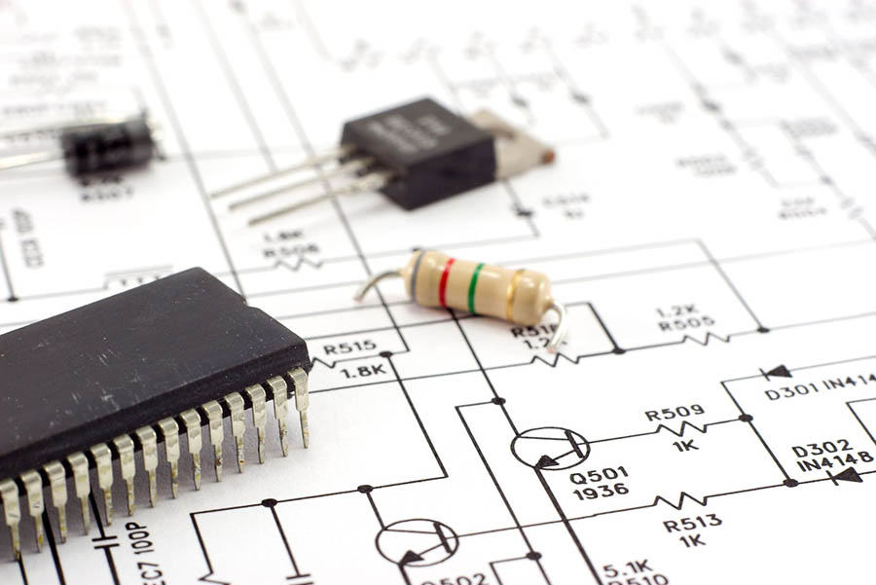
Architecture Design
Hardware Design Architecture
Design Datapath Elements
Design Control Path
Algorithm

Slide 45
Architecture Design
# Accumulator Algorithm accumulator = 0
# Loop for N data inputs input_data = get_input() # Fetch new data
accumulator += input_data # Accumulate (accumulator = accumulator + input_data)
# Output the final accumulated value print(accumulator)
clk
rst
Input_data(4 bits)
Adder
Reg
add_out
acc
(5 bits)
(5 bits)
dff_out
(5 bits)
Hardware Design Architecture of the Accumulator
Algorithm of the Accumulator

Slide 46
Architecture Design
# Accumulator Algorithm accumulator = 0
# Loop for N data inputs input_data = get_input() # Fetch new data
accumulator += input_data # Accumulate (accumulator = accumulator + input_data)
# Output the final accumulated value print(accumulator)
clk
rst
Input_data(4 bits)
Adder
Reg
add_out
acc
(5 bits)
(5 bits)
dff_out
(5 bits)
Hardware Design Architecture of the Accumulator
Algorithm of the Accumulator

Slide 47
Architecture Design
# Accumulator Algorithm accumulator = 0
# Loop for N data inputs input_data = get_input() # Fetch new data
accumulator += input_data # Accumulate (accumulator = accumulator + input_data)
# Output the final accumulated value print(accumulator)
clk
rst
Input_data(4 bits)
Adder
Reg
add_out
acc
(5 bits)
(5 bits)
dff_out
(5 bits)
Hardware Design Architecture of the Accumulator
Algorithm of the Accumulator

Slide 48
Architecture Design
# Accumulator Algorithm accumulator = 0
# Loop for N data inputs input_data = get_input() # Fetch new data
accumulator += input_data # Accumulate (accumulator = accumulator + input_data)
# Output the final accumulated value print(accumulator)
Accumulator
Input_data(4 bits)
Adder
Reg
acc
clk
rst
Hardware Design Architecture of the Accumulator
Algorithm of the Accumulator

Slide 49
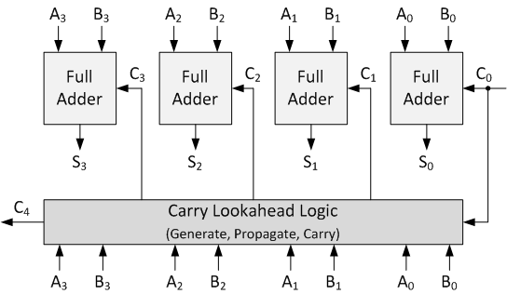
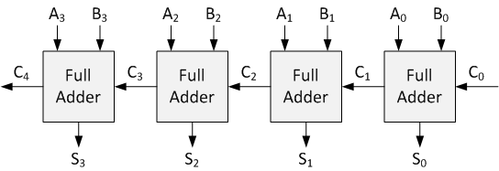
Datapath Element Design
Ripple Carry Adder
Carry Look Ahead Adder

Slide 50
Datapath Element Design
Ripple Carry Adder
Carry Look Ahead Adder
Pros:
Simple design and easy to implement.
Low area and power consumption for small bit-width adders.
Cons:
Slow for large bit-widths due to the sequential carry propagation (linear delay).
Propagation Delay: Increases linearly with the number of bits.
Pros:
Much faster than RCA, especially for wide adders.
Parallel carry computation reduces critical path delay.
Cons:
More complex design (requires additional logic for generate/propagate).
Higher area and power consumption due to extra gates.

Slide 51
Datapath Element Design
Ripple Carry Adder
Critical Path
Carry Look Ahead Adder
Pros:
Simple design and easy to implement.
Low area and power consumption for small bit-width adders.
Cons:
Slow for large bit-widths due to the sequential carry propagation (linear delay).
Propagation Delay: Increases linearly with the number of bits.
Pros:
Much faster than RCA, especially for wide adders.
Parallel carry computation reduces critical path delay.
Cons:
More complex design (requires additional logic for generate/propagate).
Higher area and power consumption due to extra gates.

Slide 52
CLA Carry Equations
For each bit i (i = 0 to 3):
A[i], B[i]: Input bits
G[i] = A[i] · B[i] → Generate
P[i] = A[i] ⊕ B[i] → Propagate
Given C0 as the input carry:
C1 = G0 + (P0 · C0)
C2 = G1 + (P1 · G0) + (P1 · P0 · C0)
C3 = G2 + (P2 · G1) + (P2 · P1 · G0) + (P2 · P1 · P0 · C0)
C4 = G3 + (P3 · G2) + (P3 · P2 · G1) + (P3 · P2 · P1 · G0) + (P3 · P2 · P1 · P0 · C0)

Slide 53
How Are Simulators Used?
Testbench generates stimulus and checks response
Coupled to model of the system
Pair is run simultaneously
Testbench
System Model
Stimulus
Response
Result checker

Slide 54
Looking back at our multiplexer
“Dataflow” Descriptions of Logic
//Dataflow description of mux
module mux2 (in0, in1, select, out);
input in0,in1,select;
output out;
assign out = (~select & in0)
| (select & in1);
endmodule // mux2
Alternative:
assign out = select ? in1 : in0;

Slide 55
TestBench of the Multiplexer
Testbench
module testmux;
reg a, b, s;
wire f;
reg expected;
mux2 myMux (.select(s), .in0(a), .in1(b), .out(f));
initial begin
$dumpfile("wave.vcd");
$dumpvars(0, testmux);
end
initial
begin
s=0; a=0; b=1; expected=0;
#10 a=1; b=0; expected=1;
#10 s=1; a=0; b=1; expected=1;
end
initial
$monitor(
"select=%b in0=%b in1=%b out=%b, expected out=%b time=%d",
s, a, b, f, expected, $time);
endmodule // testmux

Slide 56
Thank You

